Slide 1

Development of a scalable architecture to extract metadata from distributed medical databases​
André Silva Pedrosa​
Master's Dissertation in Informatics Engineering​
Supervisor: José Luis Guimarães Oliveira

Slide 2

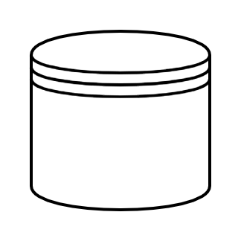
Context
Researchers want to perform studies
EHR Databases
No direct access to data

Slide 3
Context
Metadata
Researchers can find databases

Slide 4
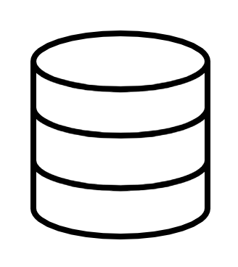
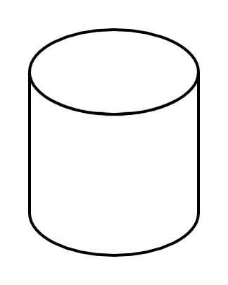
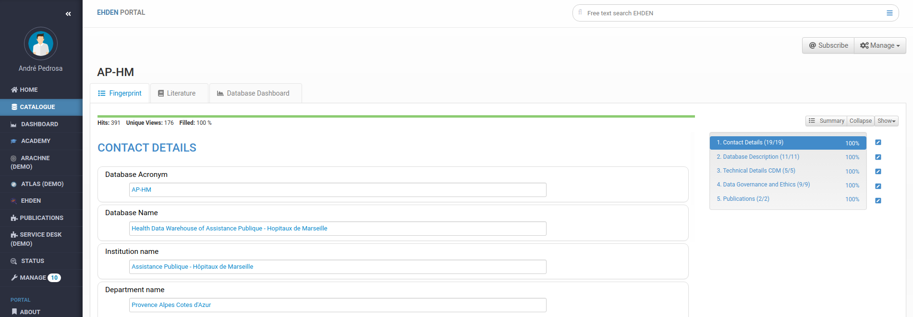

Context

Slide 5
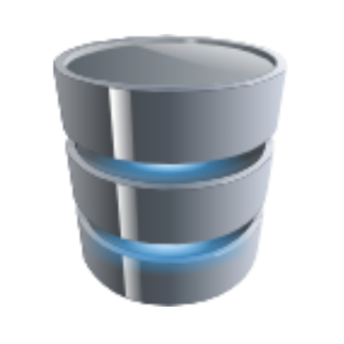

Context

Slide 6
Objectives
Provide a platform capable of holding and displaying metadata in an intuitive and user-friendly way
Develop or find a tool that extracts metadata from a database
Design a system capable of sending data to the platform, to keep it up-to-date

Slide 7
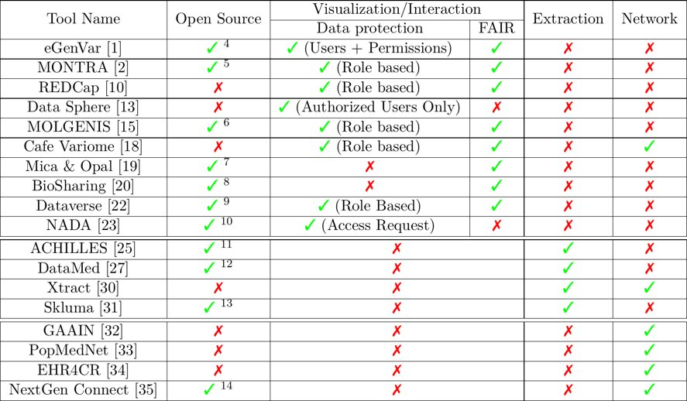
Background

Slide 8
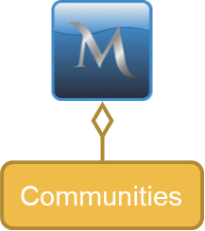
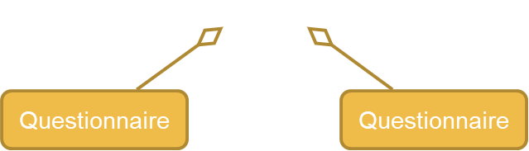
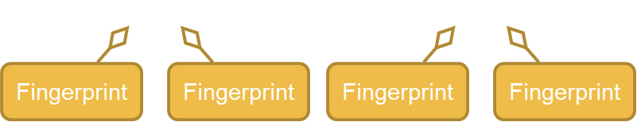
Metadata Visualization: MONTRA
Database-Centric design
FAIR access to data provided
Implemented in Django/Python
Key Concepts
Communities
Questionnaires
Fingerprints

Slide 9
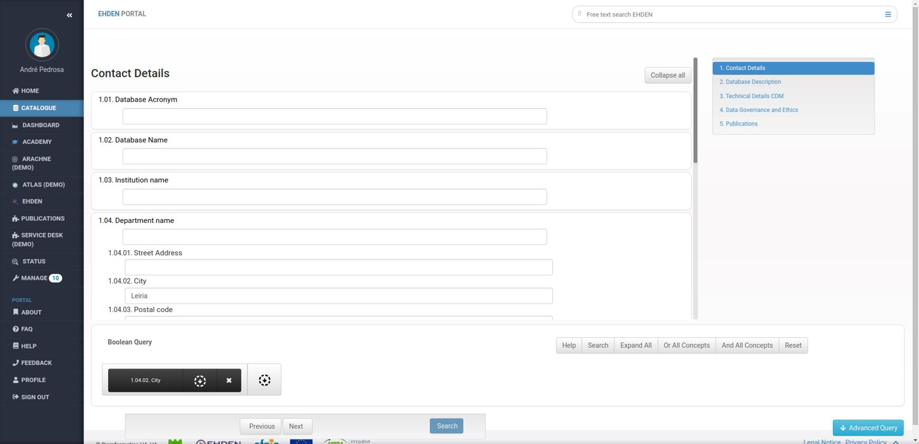
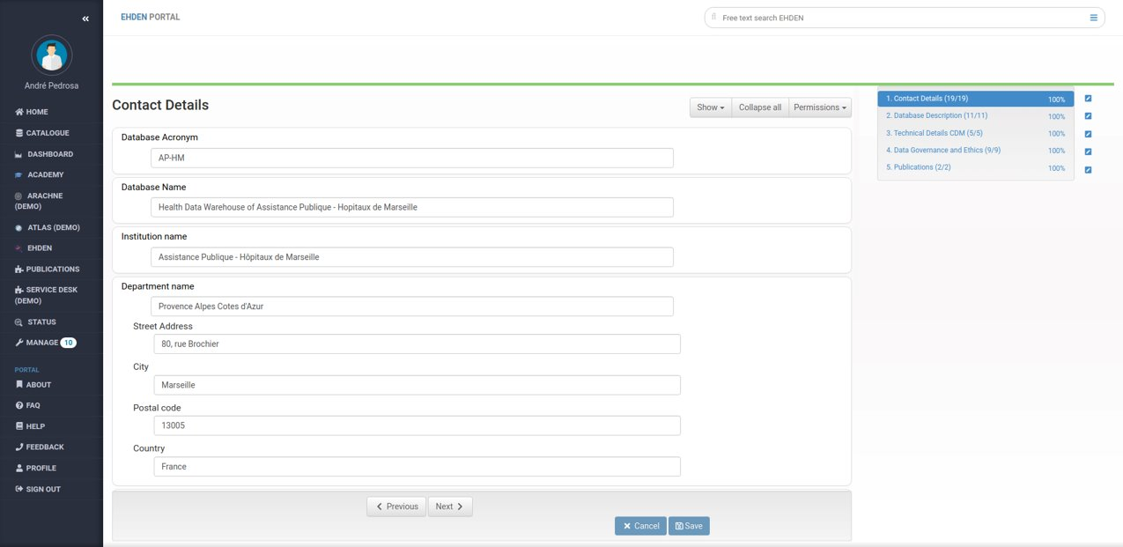
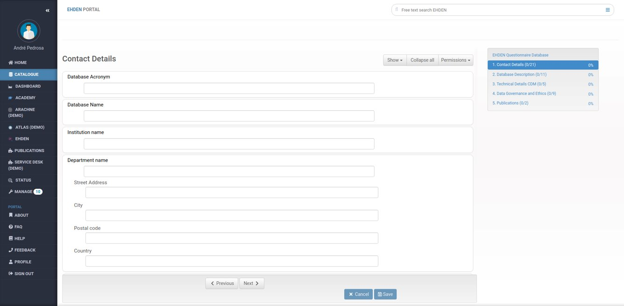
Fingerprint User Interface

Slide 10
Fingerprint User Interface

Slide 11
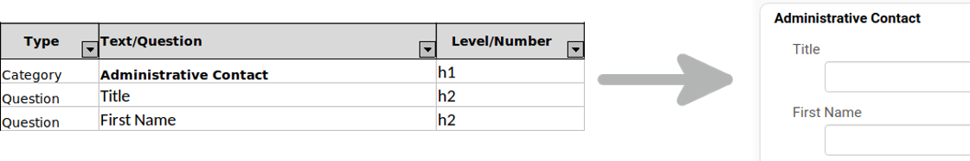
Fingerprint Schema

Slide 12
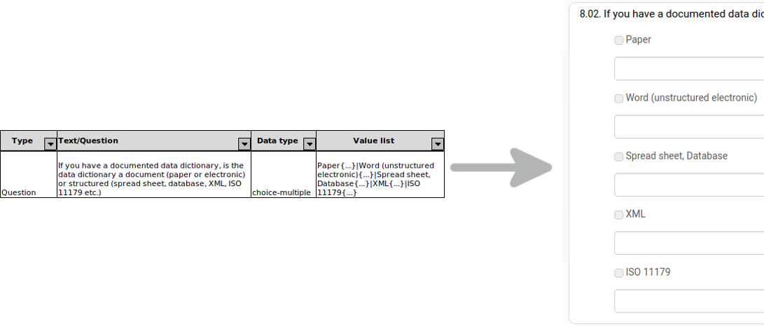
Fingerprint Schema

Slide 13
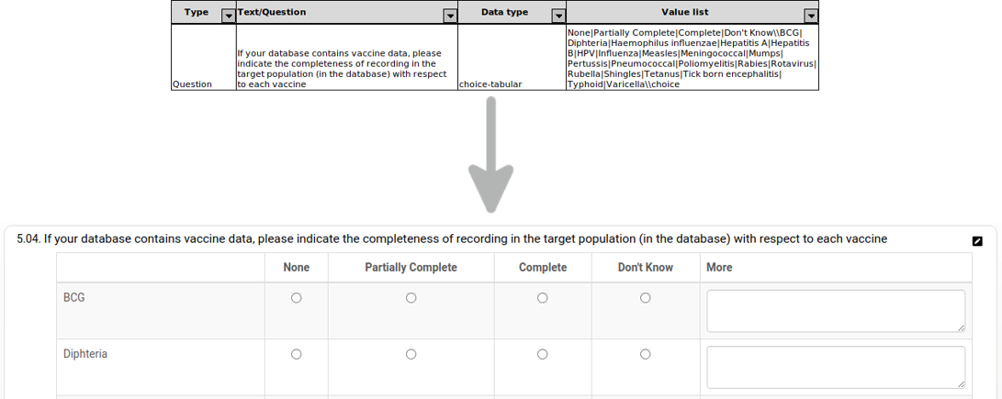
Fingerprint Schema

Slide 14
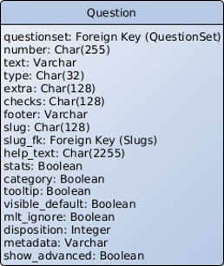
Data Models
All answers' data is stored as text;​
Only 4 models to store information about a questionnaire:​
Questionnaire, QuestionSet, Question and Choice;​
Question model with a high number of fields to store information associated with different question types;

Slide 15
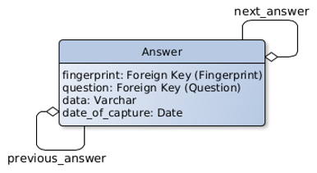
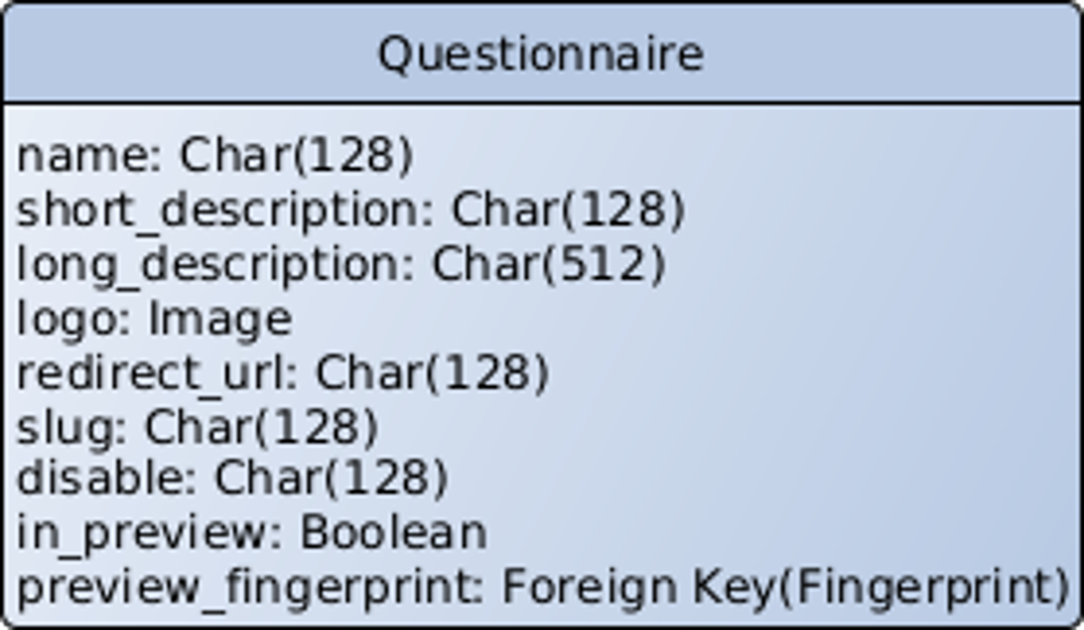
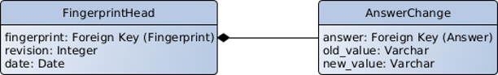
Data Models
Other models, related to fingerprints, also had duplicated information and used incorrect data types.

Slide 16
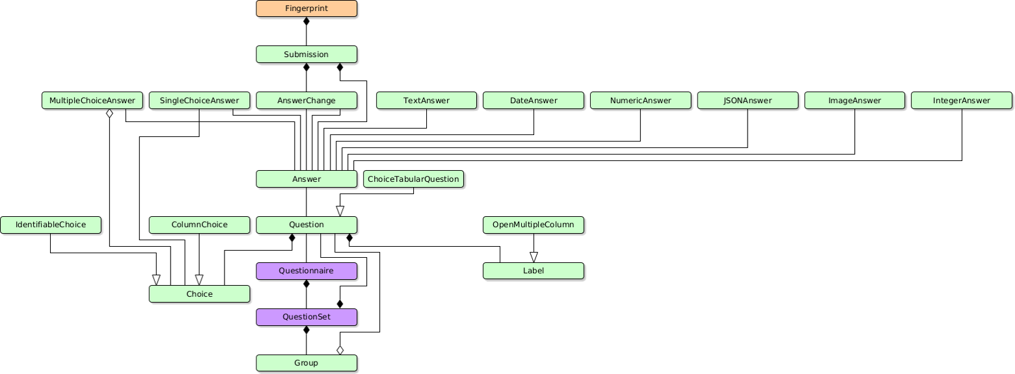
Refactoring: Data Models
Other models, related to fingerprints, also had duplicated information and used incorrect data types.

Slide 17
Refactoring: Fingerprint Views

Slide 18
Refactoring: Fingerprint Data Manipulation
Move the data validation to the backend​;
Make use of Django's built-in data validation system​;

Slide 19
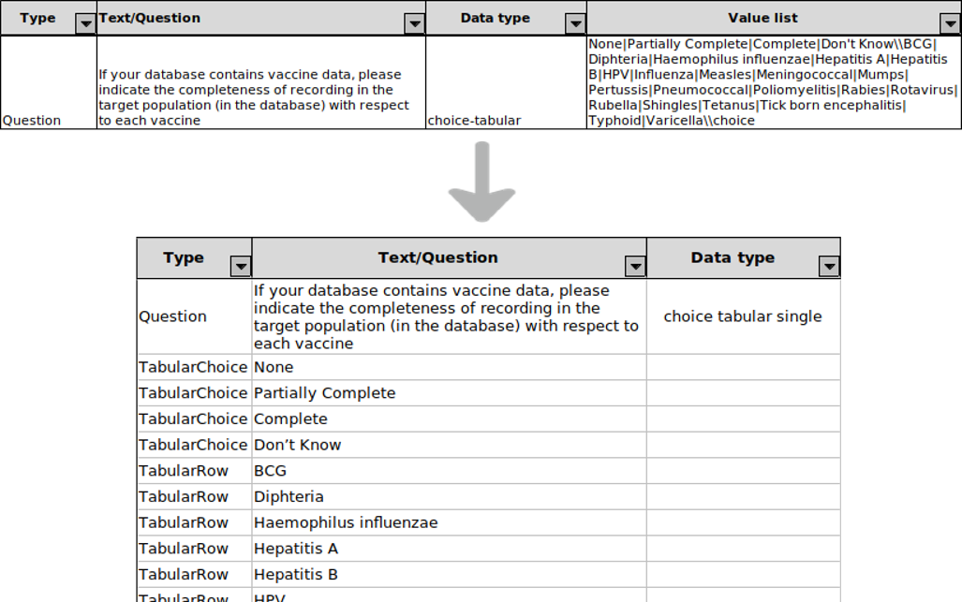
Refactoring: Fingerprint Schema
Fixed clutter problems​
Removed unused columns​

Slide 20
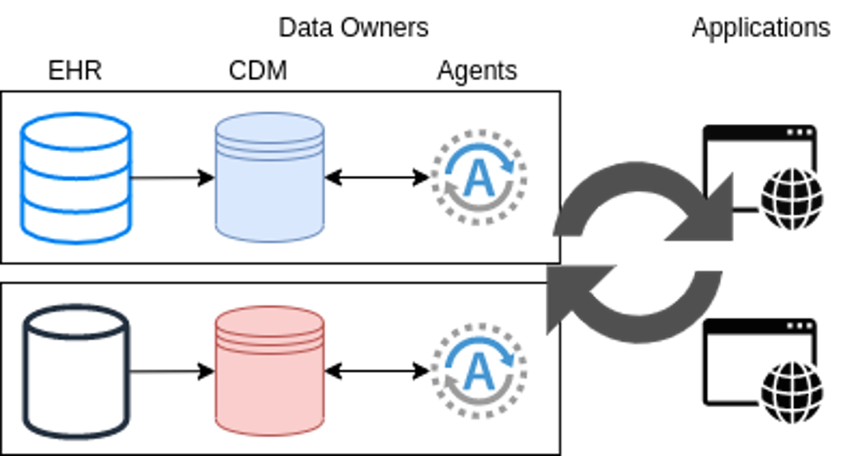
Metadata Extraction & Update
Agents:​
Run on data owner's deployment environment;​
Extracts and sends metadata to the applications;​
Data owners might not want/be able to provide direct access to data;

Slide 21
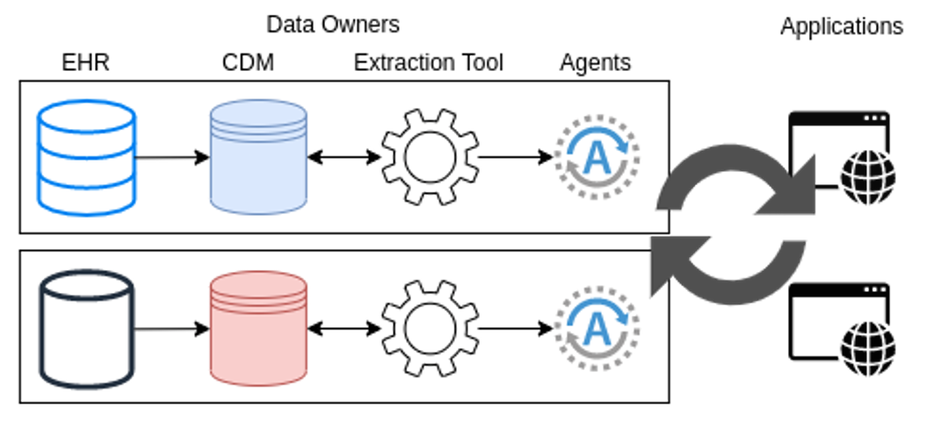
Metadata Extraction & Update
Agent is now only in charge of sending metadata to applications;​
Data owners take care of the extraction process​;
How data gets to the applications?​
Peer-to-peer architecture?

Slide 22
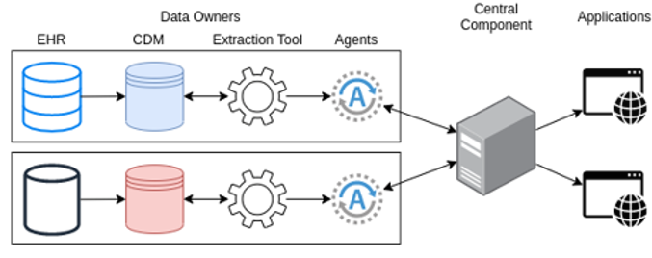
Metadata Extraction & Update
A central component receives the data from the agents and sends it to the applications;

Slide 23
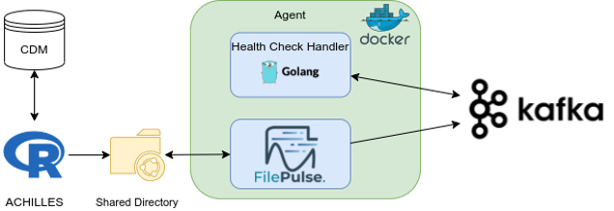
Metadata Extraction
ACHILLES​
Asynchronous messaging systems:​
Kafka​
FilePulse Source connector

Slide 24
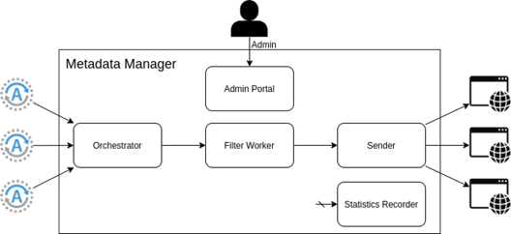
Metadata Update
Data is in Kafka, now what?​
Kafka Sink connectors do not allow customization;​
Kafka deals with data as unbounded data flow;​
Metadata Manager​
5 components

Slide 25
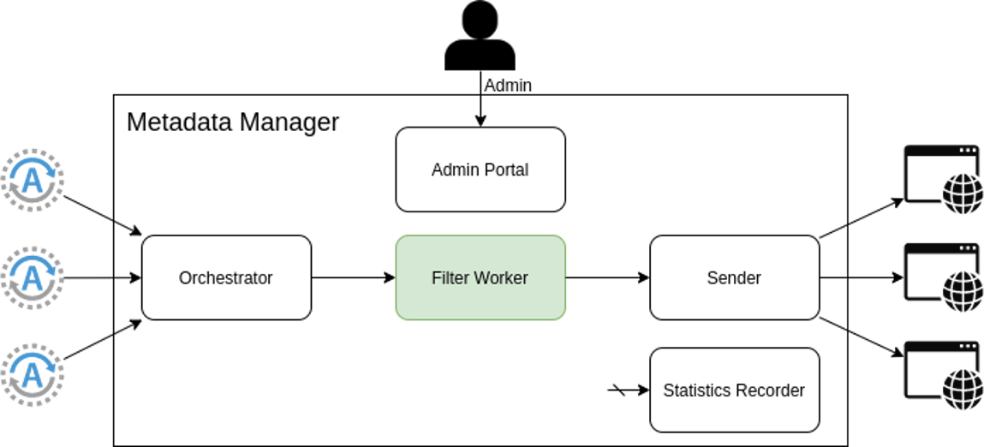
Filter Worker
Application might not require the entire data received from the databases;​
Several filters at the same time;​
Implemented in Go;​
Can be scaled out.​

Slide 26
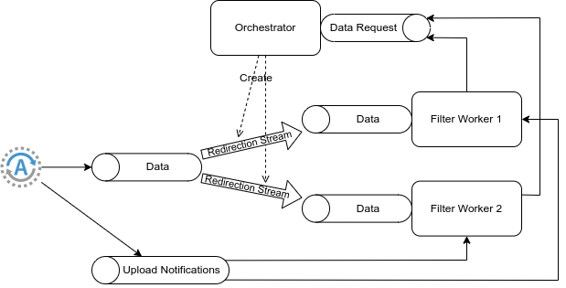
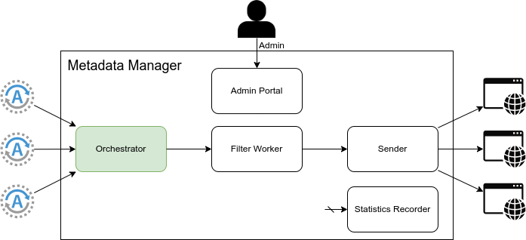
Orchestrator
Distributes the data received from the databases across the existing Filter Worker instances;​
Uses Kafka Streams library;​
Implemented in Java;​
Can be scaled out;​

Slide 27
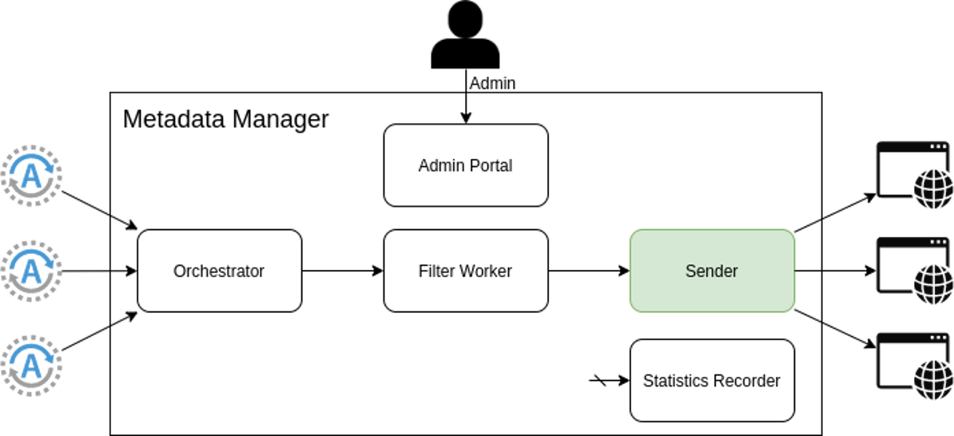
Sender
Sends data to the applications in form of a HTTP request;​
Allows customization of the several request properties (method, URL, body, ...);​

Slide 28
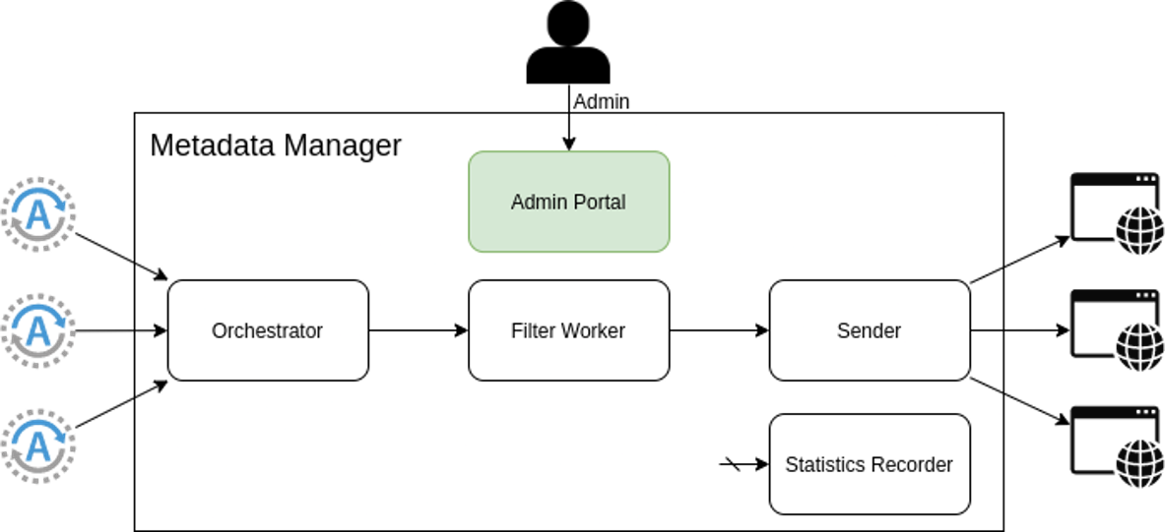
Admin Portal
Offers an interface to manage the whole Metadata Manager;​
Used to:
register new databases;​
group databases in communities;​
check statistics to get feedback on data flowing on the system;​
specify the format template of data to be sent for each application.
Composed by two components:​
Frontend - built using React;​
Backend API - built using Django.​

Slide 29
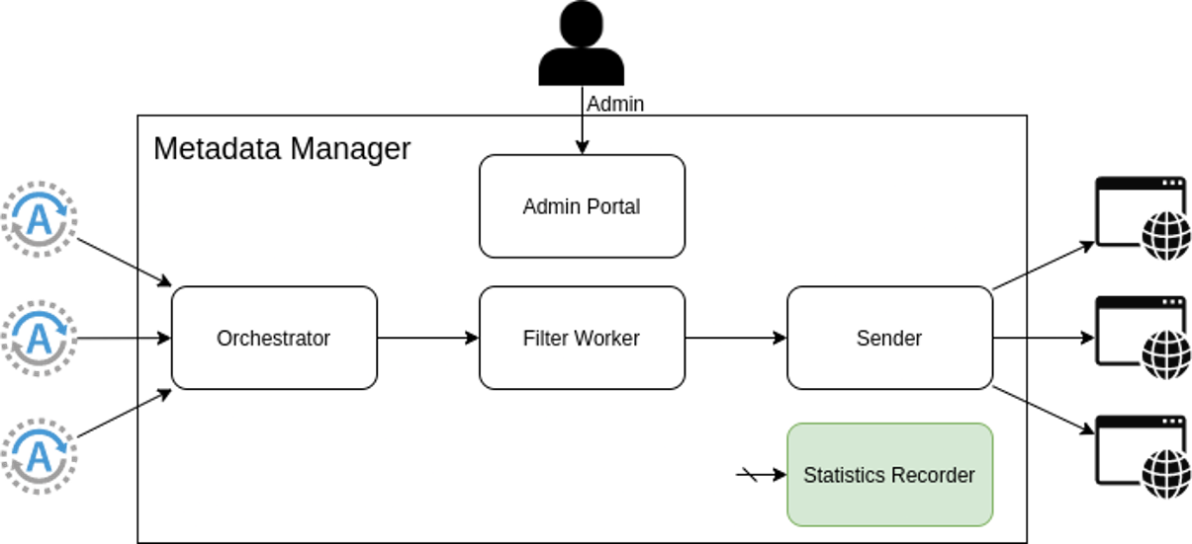
Statistics Recorder
Stores statistics of the system;​
Implemented as a Kafka Sink Connectors.

Slide 30
Demo

Slide 31
Results
Montra Refactoring - Improvements were done to a fully-fledged tool for metadata visualization;​
Keep a compatible was a challenge during the development process;​
Pull request waiting for review with over 150 commits with change on about 200 files.​
Data Profiling - A tool able to extract data from databases conforming to the OMOP CDM was proposed:​
Data owner's data privacy concerns were considered;​
A System capable of gathering and sending extracted data to the applications was developed​
Simple components with well-defined objectives;

Slide 32
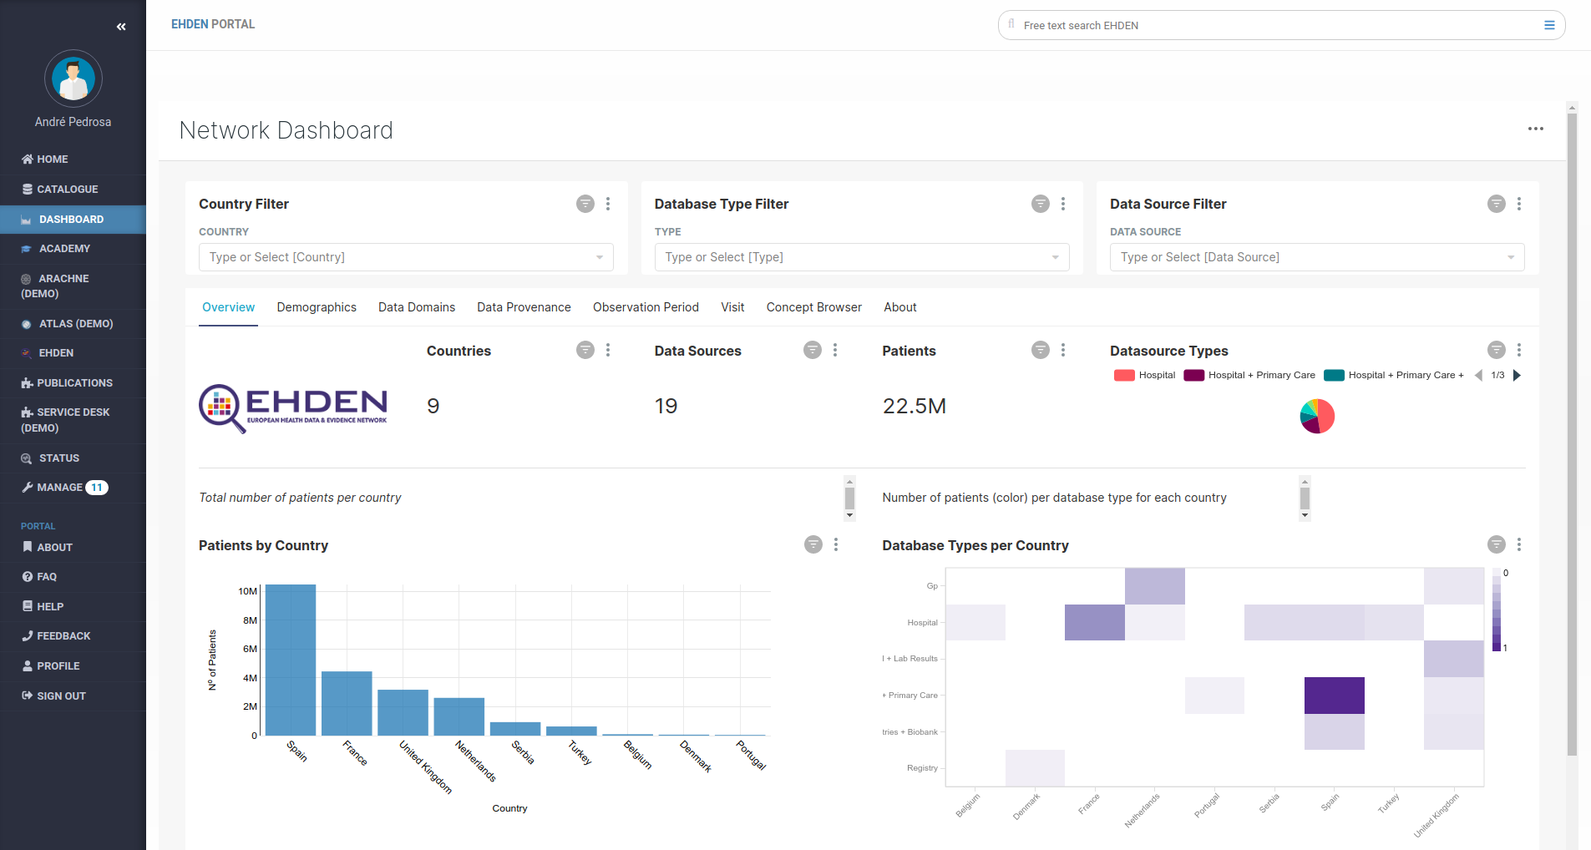
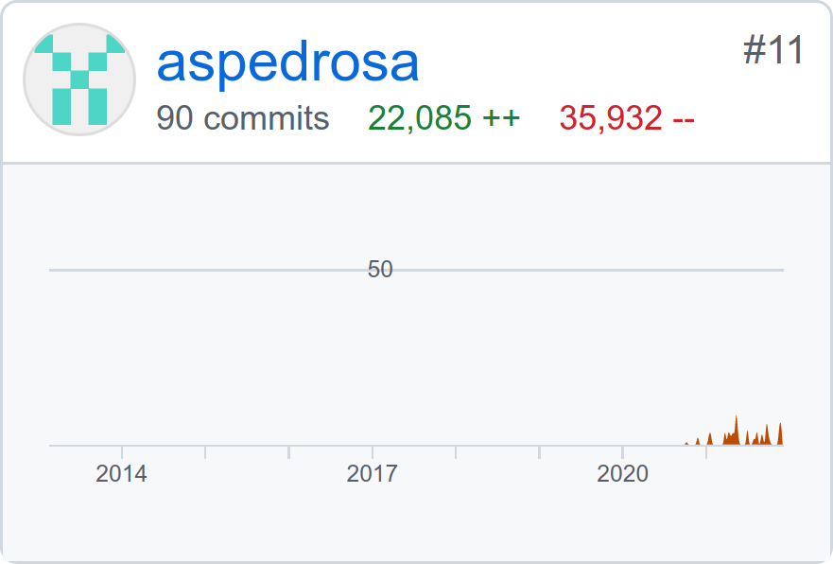
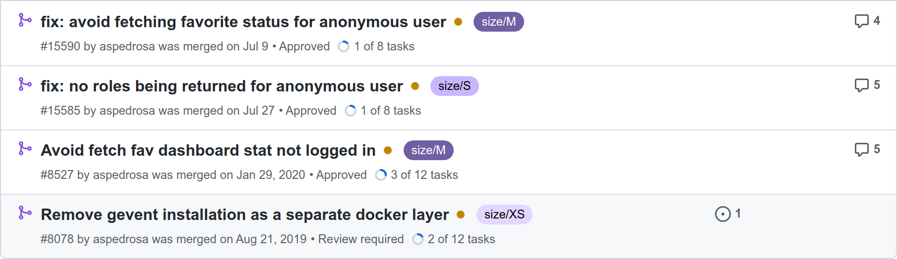
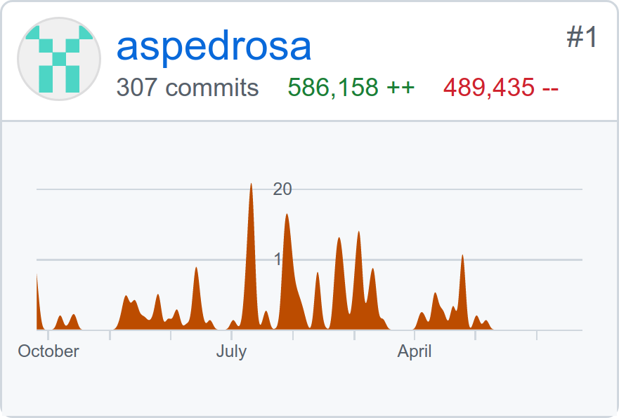
Conclusions
EHDEN WP4
GitHub
Dashboard

Slide 33
Any Questions?

